Slide 1

Anomalous origin of left coronary artery
From pulmonary artery

Slide 2
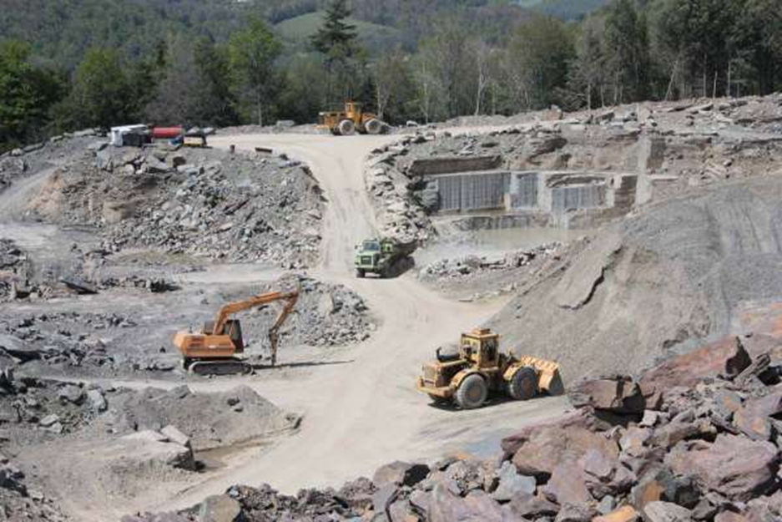
Case presentation
At (20.10.2016) O.H. a 18 years young male went to his work at the quarry where he started to work since 2 years

Slide 3

At (10 am) while he was taking his breakfast with his workmates , he had suddenly collapsed and fell to the ground , the employers immediately transported him to the ICU

Slide 4

At the ICU resuscitation efforts had made but unfortunately all had failed and sudden cardiac death was determined

Slide 5

Then he was transported to our forensic medical institute to determine the death cause

Slide 6
O.H. history dates back to his infancy period when he had an episode of cyanosis and dyspnea at the age of 7 months since that time he was misdiagnosed with unspecified cardiomyopathy and medical treatment was prescribed for him with echocardiography follow up .

Slide 7
according to his family he took all the medications properly , and didn't suffer from any complain, there was no chest pain, dyspnea, orthopnea or syncope
O.H. was a smoker since 3 years there is no family history of cardiac diseases

Slide 8
At his medical records the echocardiography which was done at 2012 showed dilatation in the left ventricle, mild mitral regurgitation, low left ventricular ejection fraction 32%

Slide 9
General appearance :
The corpse is for young male : height (175cm), weight (75kg)
There was bluish discoloration around injection puncture on the dorsum of his left hand
There is CPR burns on the chest skin due to medical intervention
The face and the neck are congested

Slide 10
Postmortem changes :
The corpse is in rigor mortis , the livor mortis is dark purple and located on the buttocks
Injuries: There is no signs of injuries or violence especially around the mouth, nose, lateral sides of the neck, and inguinal region

Slide 11
Anatomical description
Head :
The scalp is intact, there is no bruising
Skull: there is no fractures by palpation
Neck:
Neck muscles : intact
Upper & lower respiratory tracts: intact and full with food
Hyoid bone & thyroid cartilage : intact there is no fractures or Bruising

Slide 12
chest
Chest muscles : intact
Chest bones : intact, there is no fractures
Chest cavity : intact, there is no accumulation of blood or pus
Lungs: intact but severely congested , there is remnants of undigested food in the trachea
Right lung weight : 533 gram
Left lung weight : 465 gram
Heart : will be described later

Slide 13
Abdomen :
Abdominal wall muscles : intact, there is no bruising
Pelvic bones : intact, there is no fractures
Abdominal & pelvic cavity : intact, there is no accumulation of blood or pus
Liver: intact but congested, weight : 1950 gram

Slide 14
Stomach : intact, and full with undigested food
Spleen : intact but congested , (weight 185 gram)
Kidneys : intact but severely congested, right kidney weight: 135 gram and left weight 135 gram

Slide 15

Autopsy

Slide 16
                The heart weight : 400 gram

Slide 17
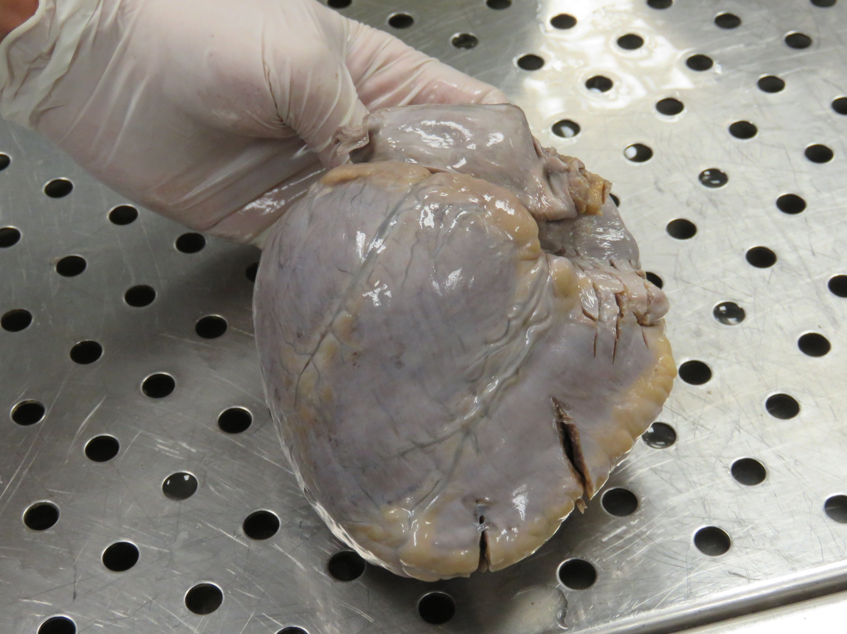

Slide 18
  The LCA arose from the pulmonary artery
  It was dilated
  With normal course

Slide 19
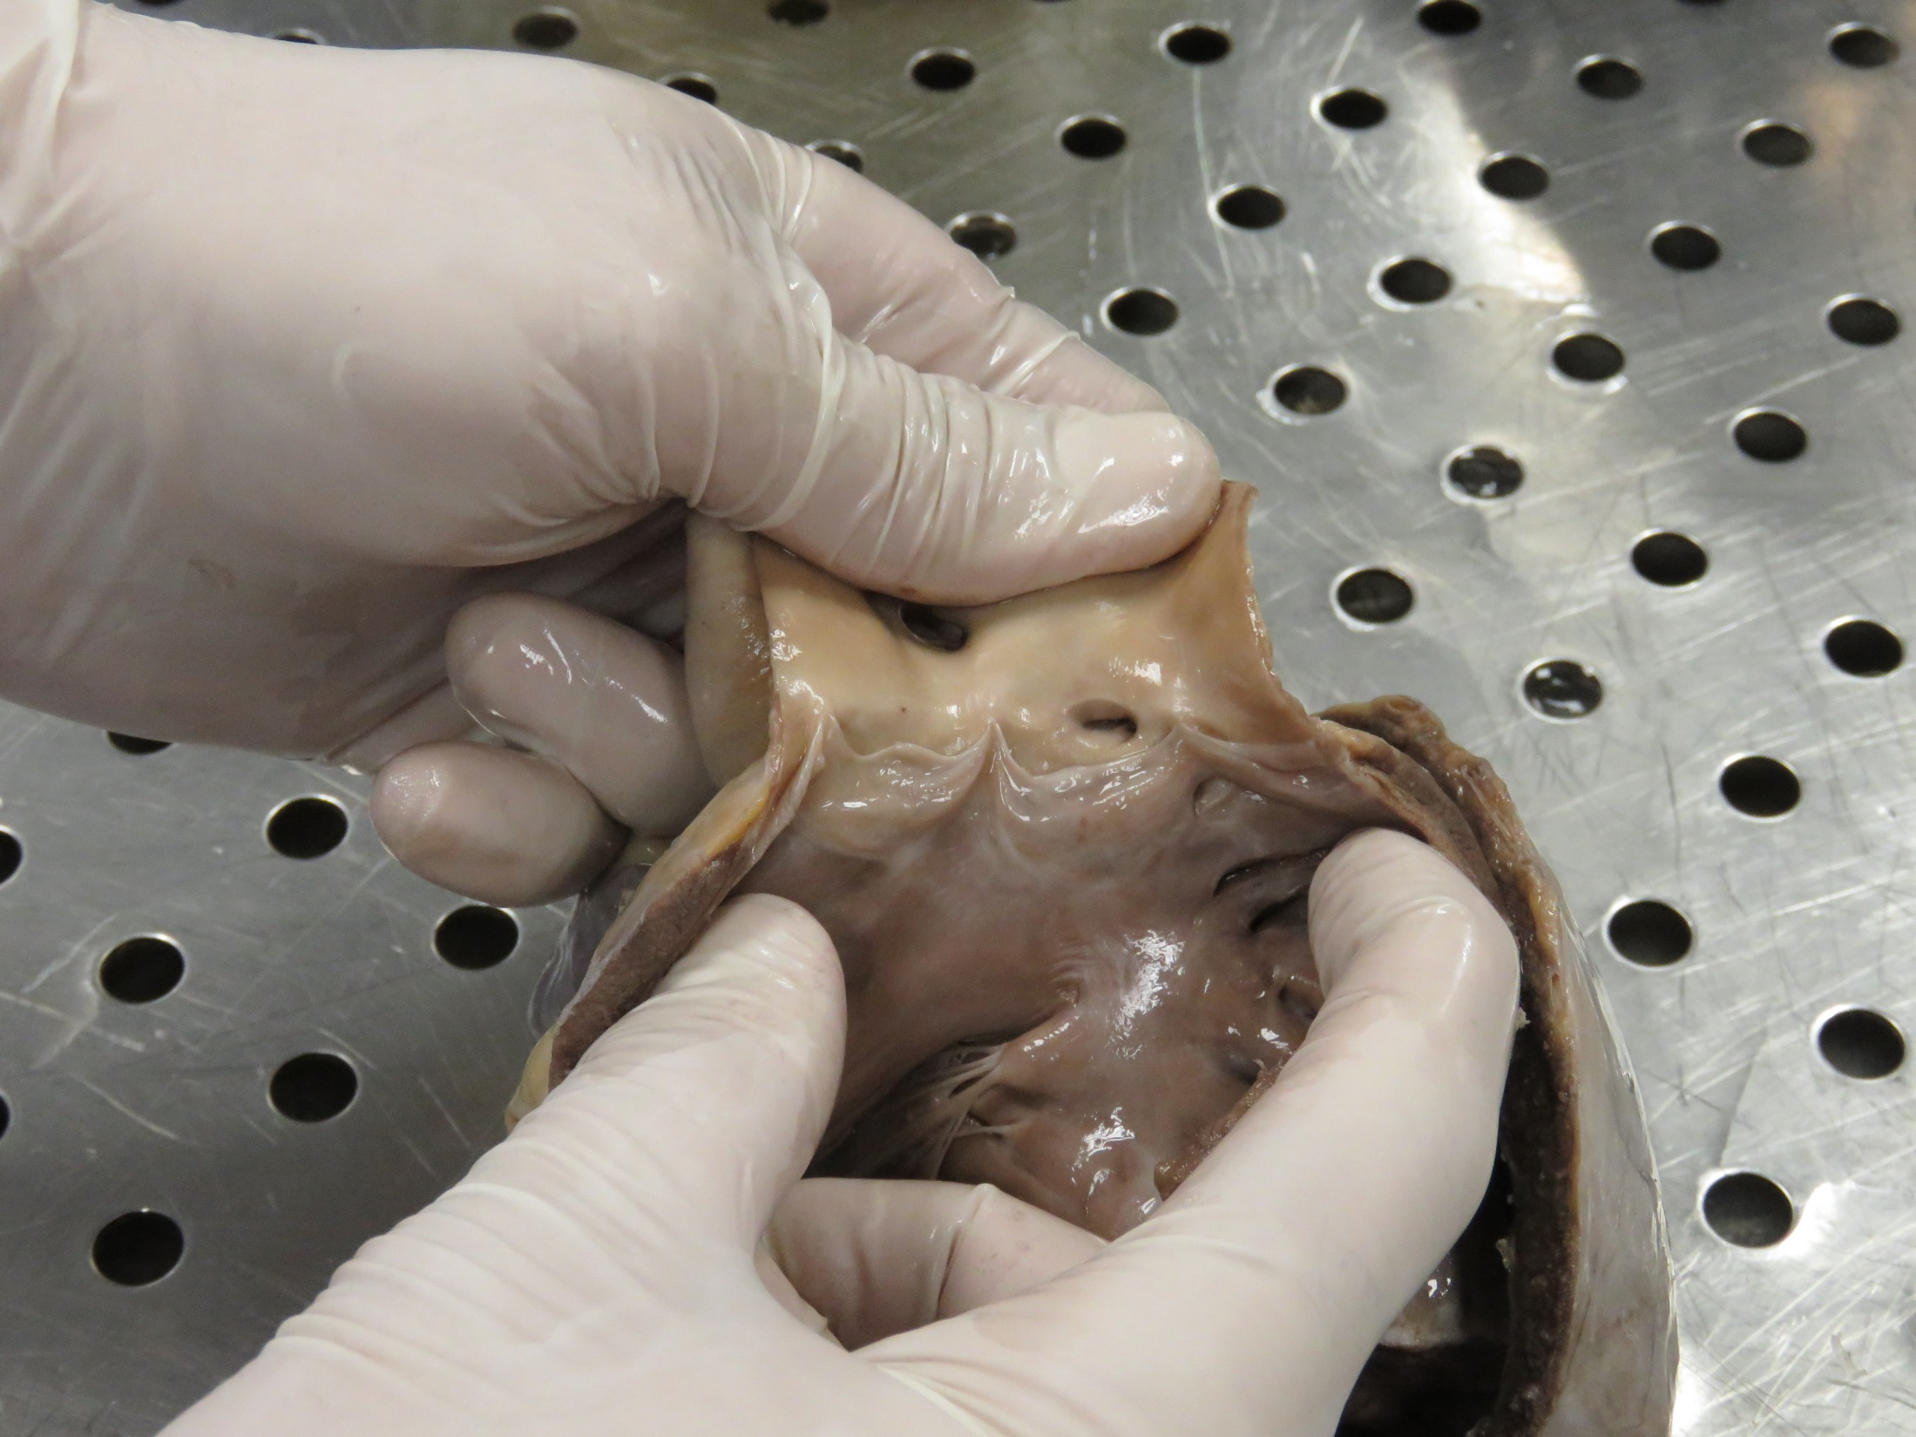
Orifice of the LCA from the pulmonary artery

Slide 20
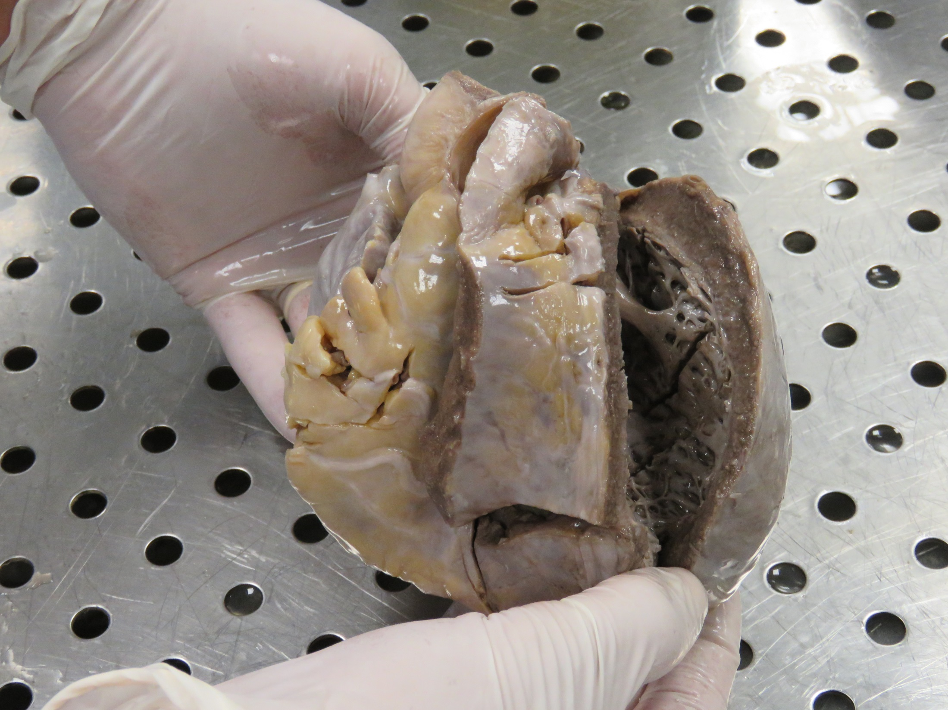
Path of left anterior descending artery ( LAD )

Slide 21
            There was cardiomegaly with left ventricular hypertrophy (Left ventricle wall thickness : 2 cm )
            There was also left ventricle dilatation with extensive diffuse sub endocardial fibrosis

Slide 22
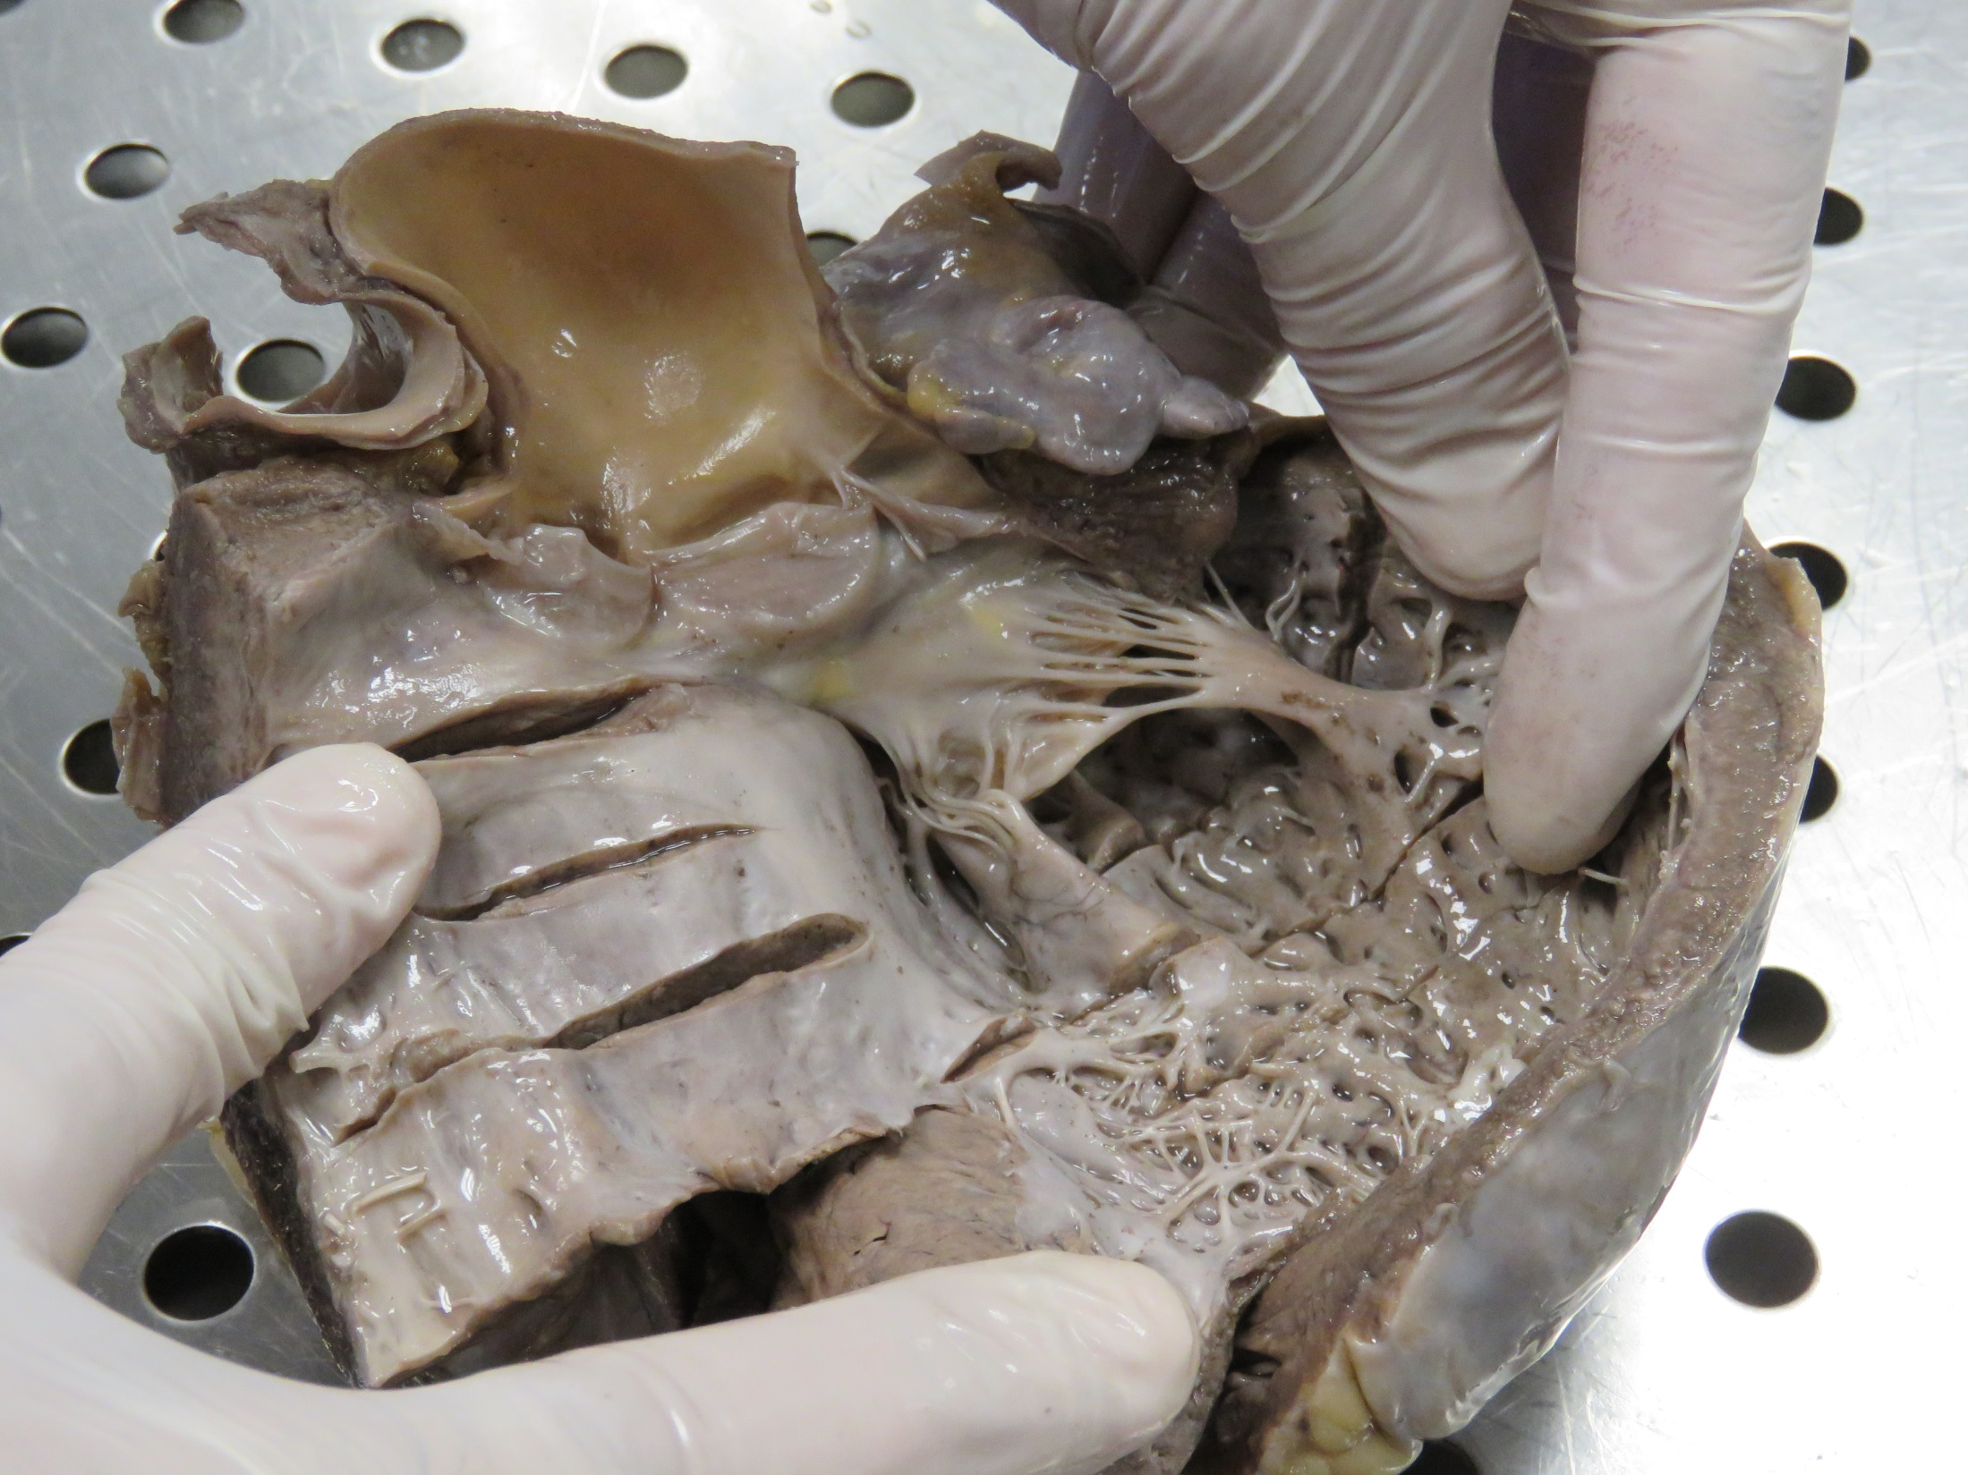
Diffuse sub endocardial
fibrosis in the left ventricle

Slide 23
  The RCA arose from the orifice of the RCA above the right cusp of aortic valve which showed marked dilatation and running a normal course
  it gives many collaterals to the left ventricle

Slide 24
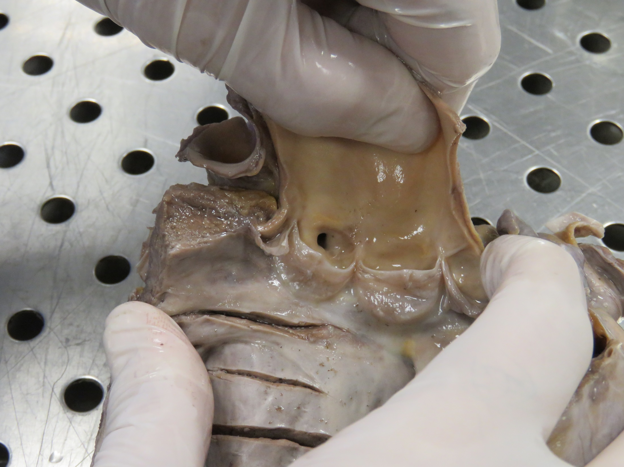
Orifice of the RCA
above the right cusp of aortic valve

Slide 25
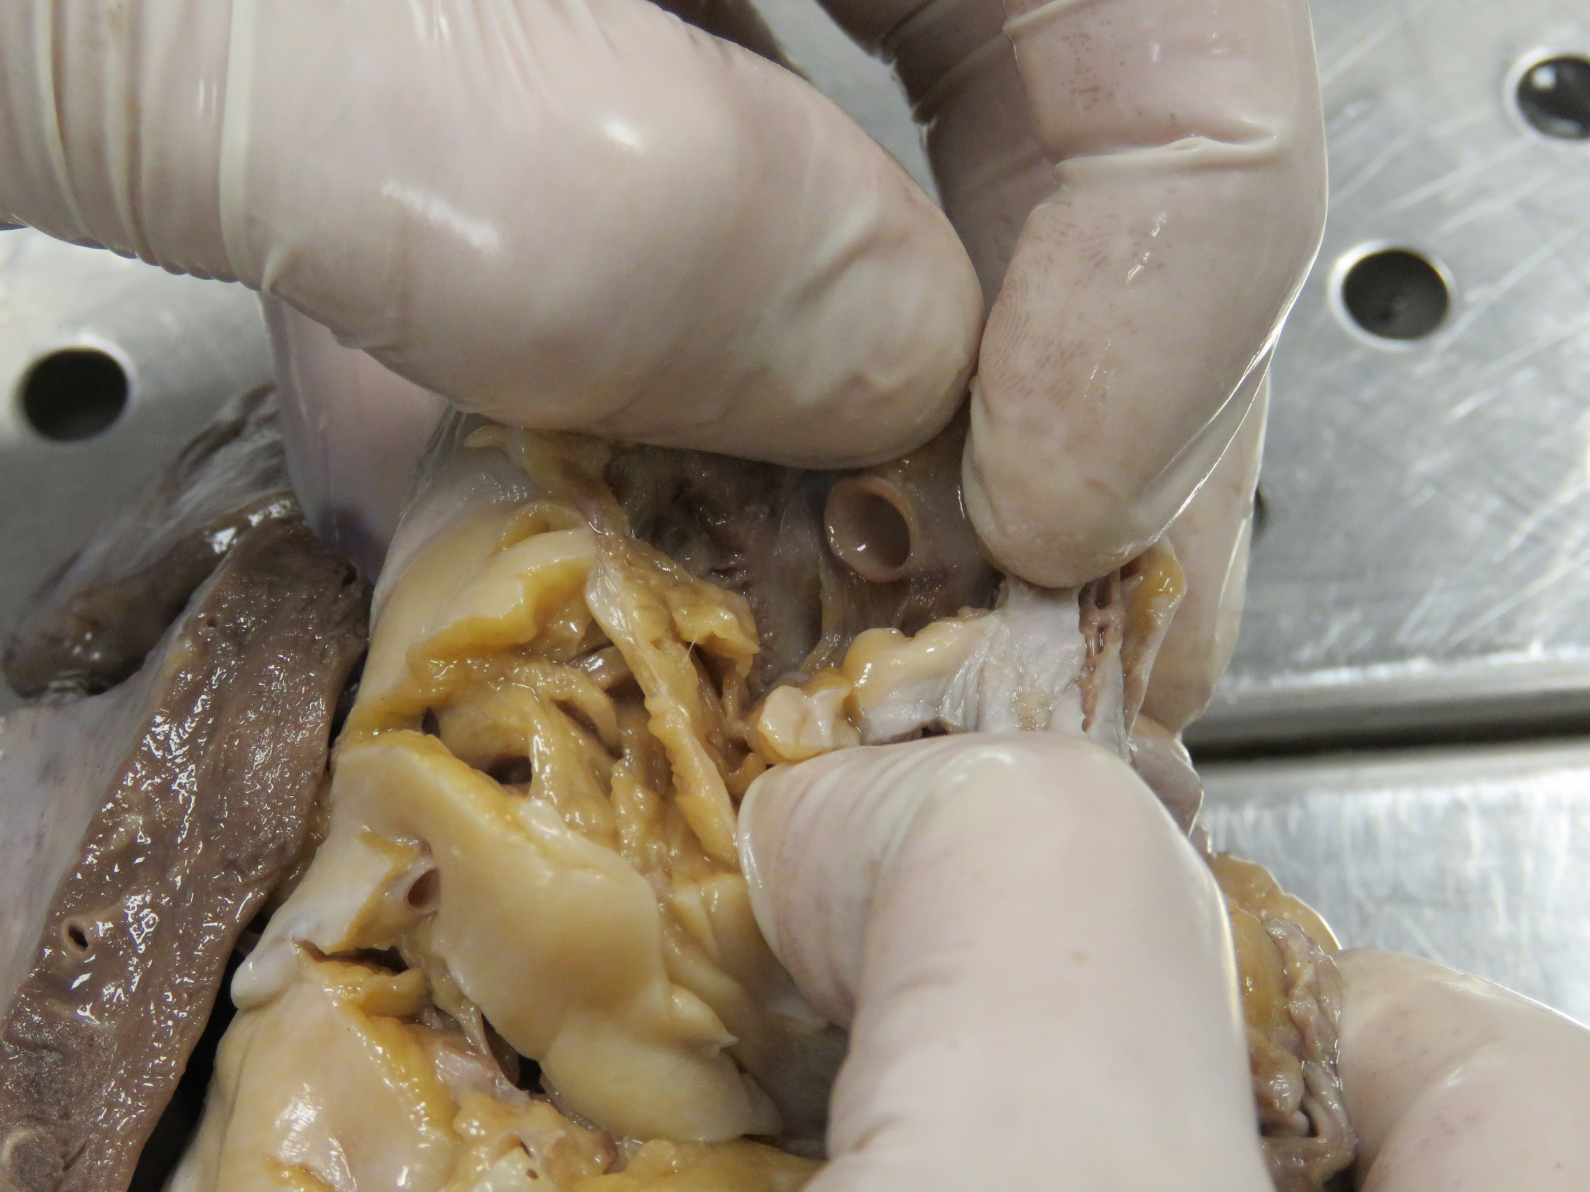
Dilated RCA

Slide 26
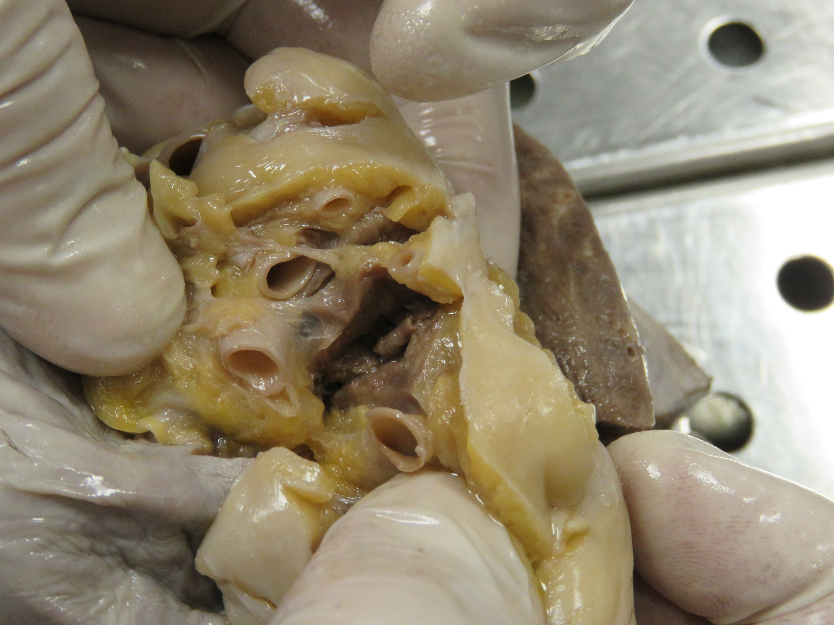
Proximal collaterals
Dilated RCA

Slide 27
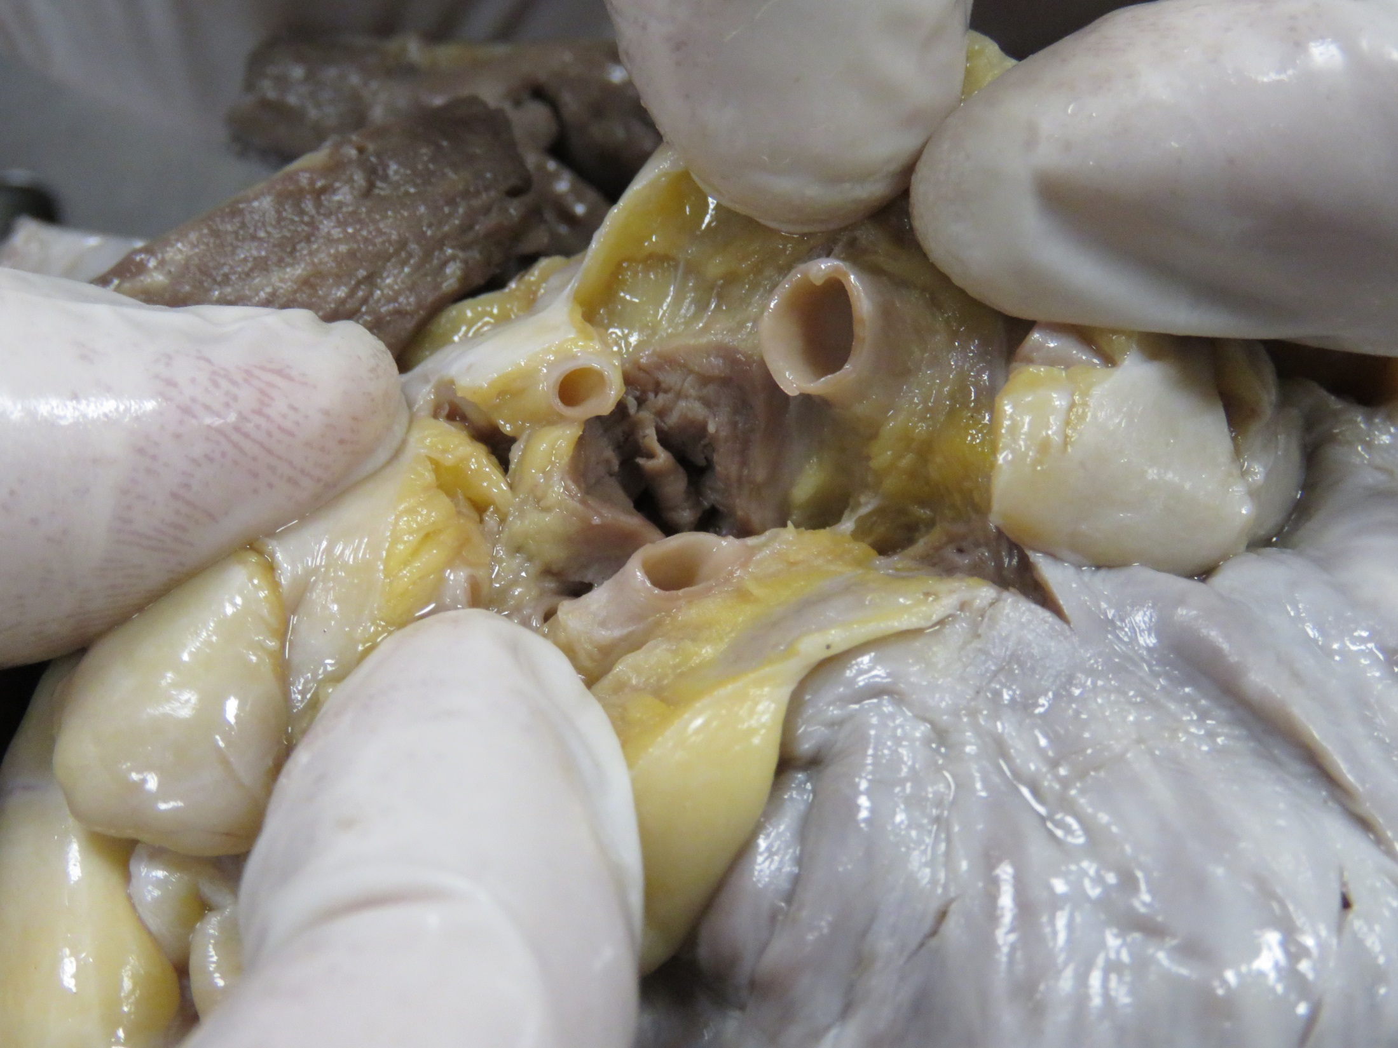
Dilated RCA
Proximal collaterals

Slide 28
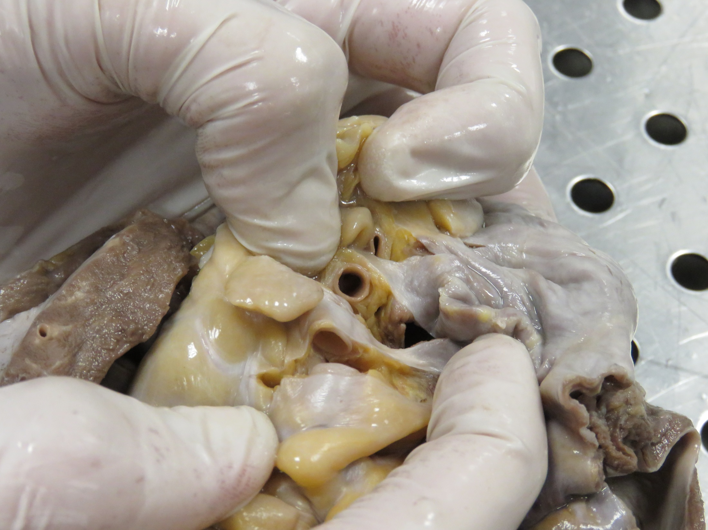
Dilated RCA

Slide 29
Histopathology

Slide 30
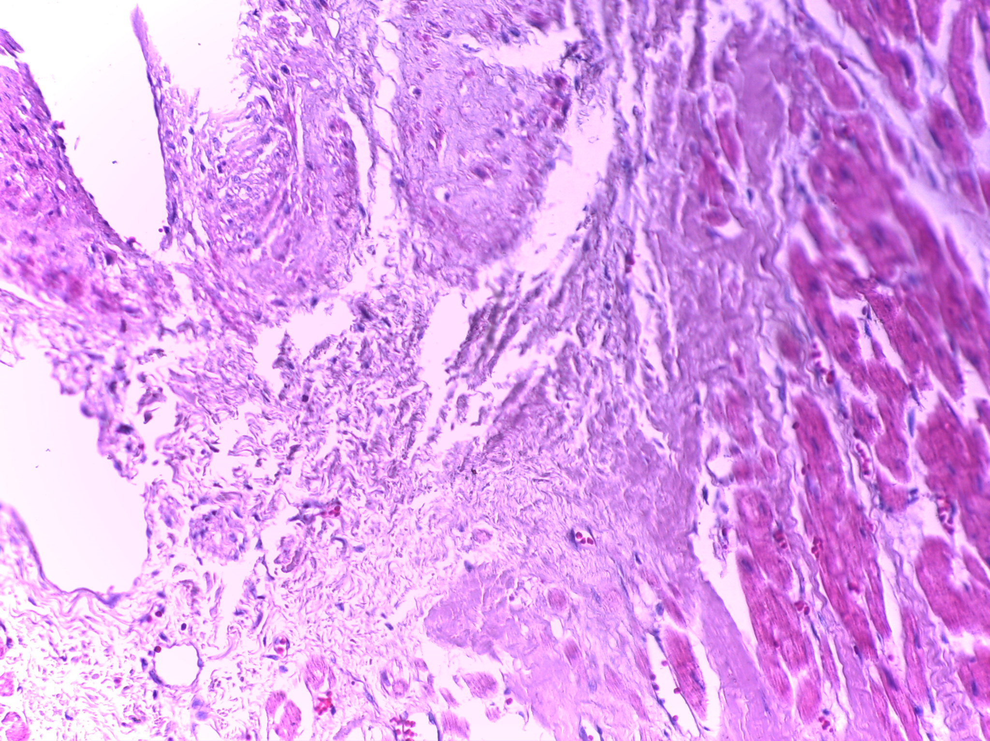

Slide 31
Proximal LCA :
Myxoid degeneration of media
Myocardium : interstitial fibrosis

Slide 32
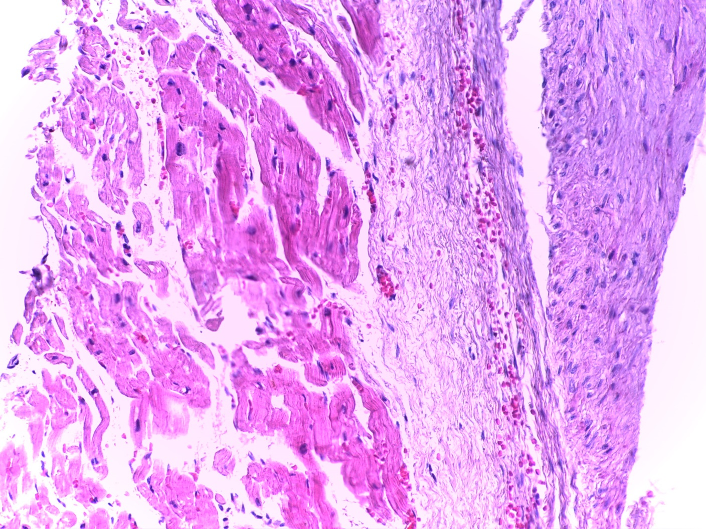

Slide 33
Distal LCA:
Myocardial biopsy : interstitial fibrosis
No cardiomyopathic changes

Slide 34
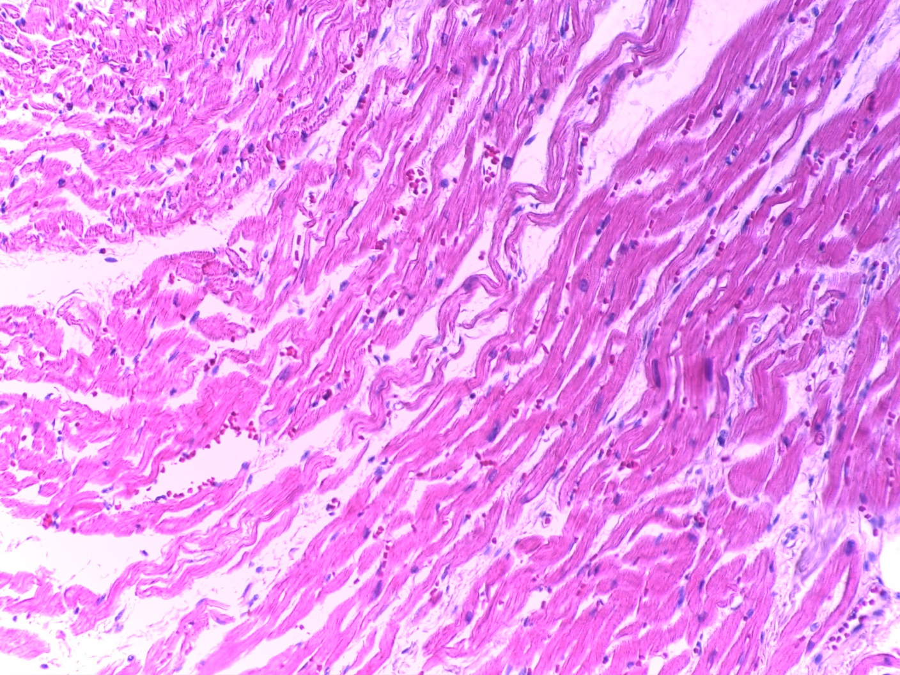

Slide 35
Proximal RCA :
Myxoid degeneration

Slide 36
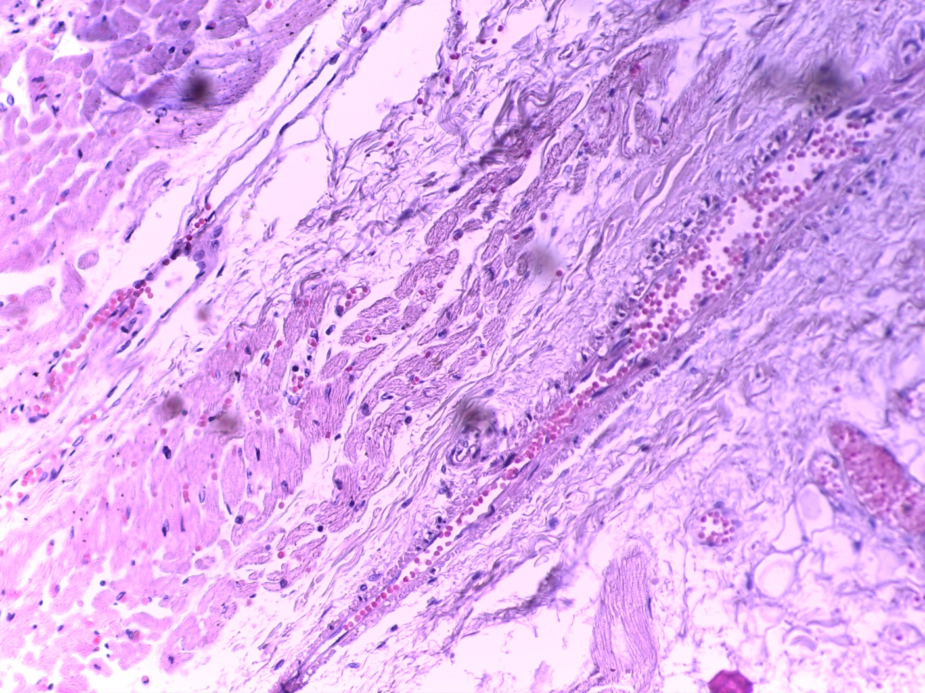

Slide 37
Distal RCA:
Normal myocardium

Slide 38
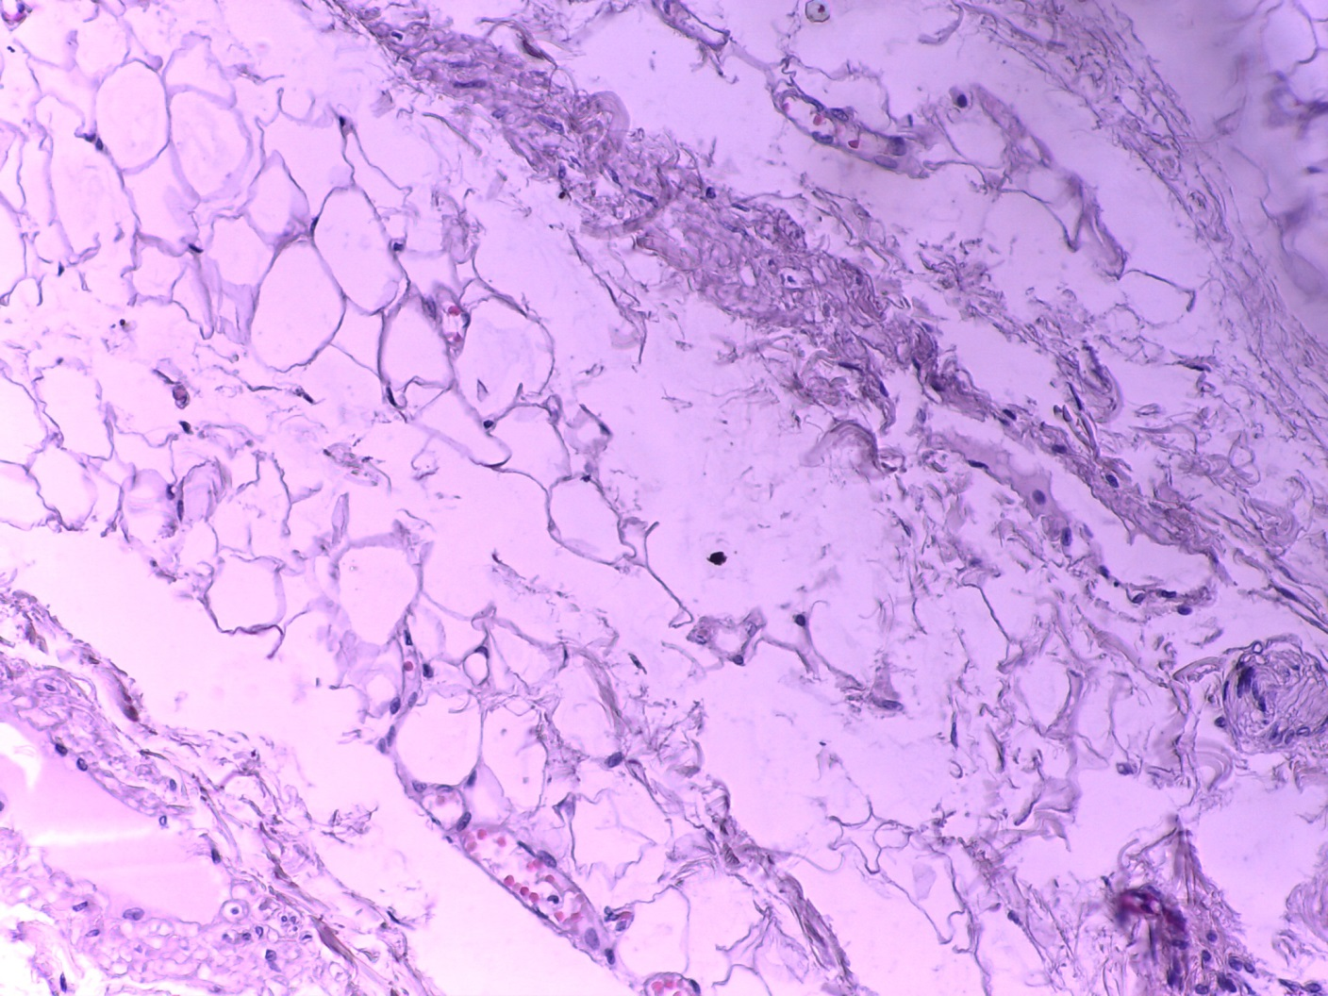

Slide 39
Right coronary artery collaterals :
Myxoid degeneration

Slide 40
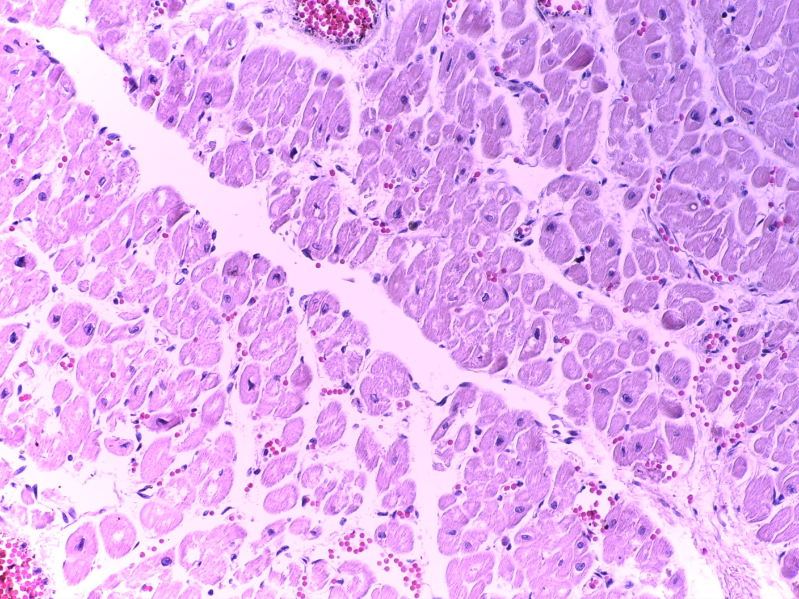

Slide 41
Left ventricle endocardium:
fibrosis

Slide 42
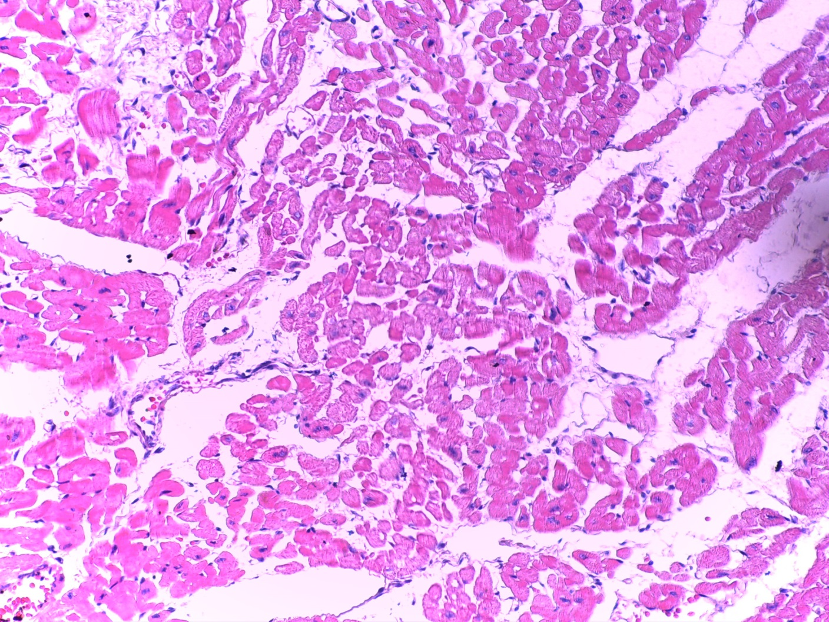

Slide 43
Papillary muscle of mitral valve:
Mild interstitial fibrosis

Slide 44
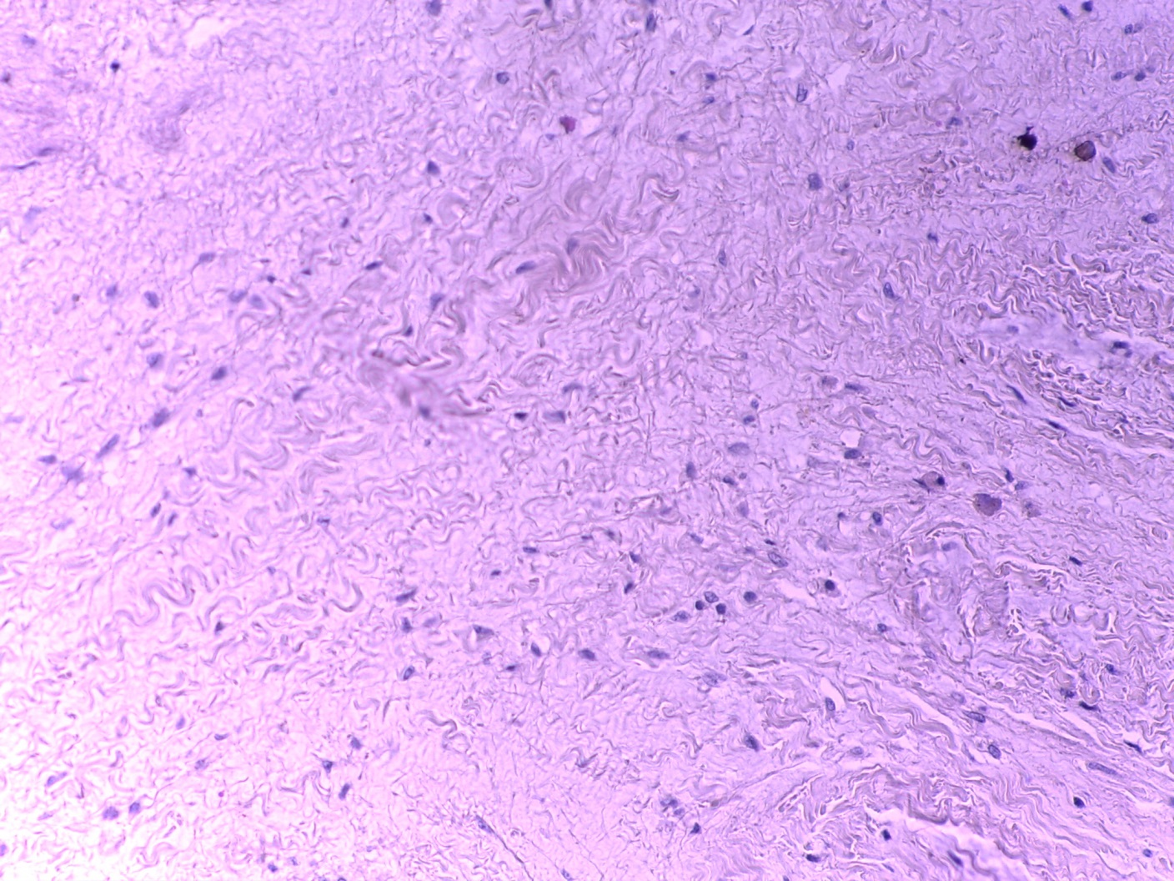

Slide 45
Leaflet of mitral valve:
Fibrosis
Myxoid degeneration

Slide 47
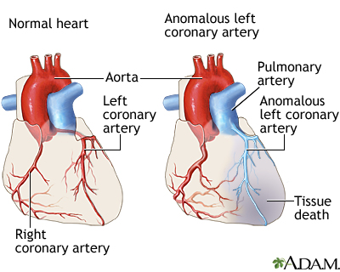
ALCAPA

Slide 48
ALCAPA
A rare congenital anomaly
Incidence : 1/ 300,000 live births
commonly presents in infancy, which if untreated has up to 85% mortality, most deaths occurring before 1 year of age
Some patients remain asymptomatic likely secondary to an extensive network of collateral vessels between the right and left coronary system.
The small minority of patients who survive to adulthood with ALCAPA will ultimately develop symptoms, or present with arrhythmia, syncope or sudden death

Slide 49
A comprehensive literature search was performed for all case reports of ALCAPA on MEDLINE and PUPMED , all adult cases defined by age 18 years and older

Slide 51
the results shows : 151 adult cases of ALCAPA , the average reported age 41 years with the oldest being 83 , they differ in the presentation of ALCAPA as follow :

Slide 52
Pathophysiology
Before birth both systemic and pulmonary pressures are equal and there is no anterograde flow in the LCA & RCA
However in the neonatal period the pulmonary vascular pressure decreases and the ductus arteriosus closes so the blood will flow into LCA

Slide 53
At this point the development of collaterals between the RCA and LCA will determine the occurrence and extent of myocardial ischemia
Patients with poor developed collaterals will become symptomatic during the first year of life (infantile type)

Slide 54
  Those with well-developed collateral circulation (adult type)
  may remain asymptomatic until adulthood
  However even those patients will become symptomatic as the flow in the LCA reversed into the pulmonary artery this lead to shunting of blood from RCA to LCA then to PA , at this stage the patients show symptoms of angina , palpitation, ventricular arrhythmia and sudden death

Slide 55
Diagnosis & Management

Slide 56
Diagnosis
At the time of presentation : some present with symptoms of angina ,dyspnea, palpitation or fatigue
Other present with ventricular arrhythmia, syncope, or sudden death A minority asymptomatic on physical examination :Most patients had murmur some demonstrated a continuous or ‘‘to-and-fro’’ murmur predominantly localized to the left sternal border or apical region

Slide 57
Investigations
ECG frequently demonstrated infarct patterns with Q-waves ; Left ventricular hypertrophy was noted and left axis deviation.
Some show normal ECG.

Slide 58
diagnostic criteria for ALCAPA using echocardiography.
This includes :
:1- identification of a dilated RCA
2- retrograde Doppler flow from the LCA to PA
3-prominent septal flow from collateralization

Slide 59
CT and MRI findings of ALCAPA in adults include:
1. direct visualization of the origin of the LCA from the posterior aspect of the PA
2. dilated and tortuous RCA
3. visualization of dilated intercoronary collateral arteries along the external surface of the heart or within the interventricular septum.

Slide 60
MRI has the additional advantage of demonstrating communication and flow from the LCA into the PA, also it is useful in assessing mitral valvular function

Slide 61
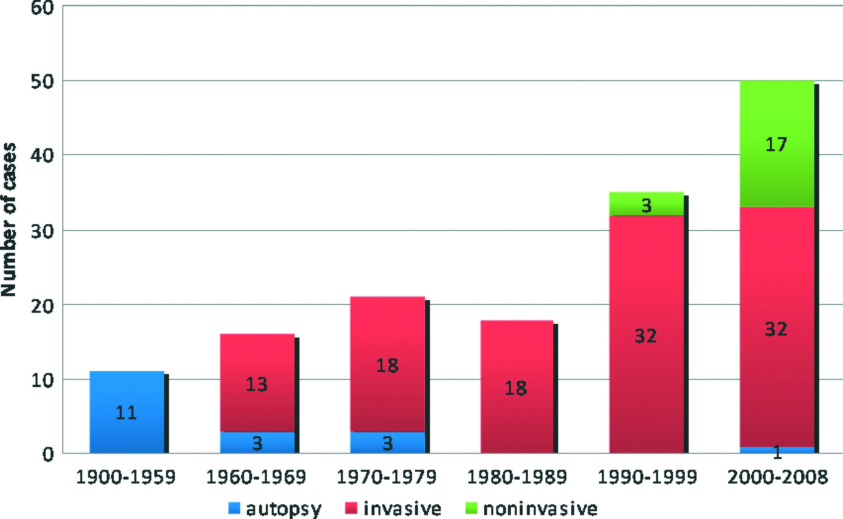
The availability of newer diagnostic modalities correlates with increased incidence of diagnosed ALCAPA

Slide 62
Management
Medical management of ALCAPA consists of standard therapy for congestive heart failure that includes diuretics, afterload reduction drugs, and inotropic agents. Once the patient has stabilized, different surgical approaches have been proposed

Slide 63
In infants: coronary button transfer is the Surgical procedure of choice

Slide 64
In adults, bypass grafting with ligation of proximal anomalous LCA with utilization of venous or arterial graft vessels to supply the LCA with arterial blood.
There has been some controversy on concomitant mitral valve repair at the time of operation for patients with MR

Slide 65
Conclusion
ALCAPA is a rare form of congenital heart disease that can lead to significant mortality and morbidity
There are individuals who survive beyond infancy secondary to more extensive formation of collateral coronary vasculature that allows retrograde perfusion of the LCA system and minimal left ventricular injury

Slide 66
References
1. Yau, James M., et al. "Anomalous Origin of the Left Coronary Artery From the Pulmonary Artery in Adults: A Comprehensive Review of 151 Adult Cases and A New Diagnosis in a 53‐Year‐Old Woman." Clinical cardiology 34.4 (2011): 204-210.
2. Quah, Jing Xian, et al. "The management of the older adult patient with anomalous left coronary artery from the pulmonary artery syndrome: A presentation of two cases and review of the literature." Congenital heart disease 9.6 (2014): E185-E194.
3. Alexi‐Meskishvili, Vladimir, et al. "Anomalous origin of the left coronary artery from the pulmonary artery in adults." Journal of cardiac surgery 10.4 (1995): 309-315.

Slide 67
Thank you

