Slide 1
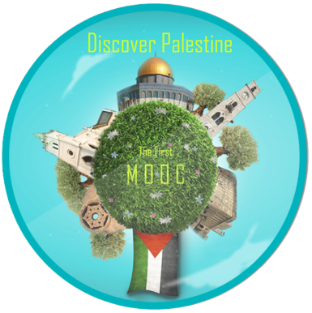
International Conference
Teaching Palestine: Pedagogical Praxis And The Indivisibility Of Justice
Discover Palestine: Reflection on Using Technology for Identity Building
Saida Affouneh

Slide 2
What is MOOC ?
Massive Open Online Course
Free of Charge
Designed for large numbers
Peer to peer learning
Meant to award completion certificates rather than course credits
First introduced in 2008
Filmed lectures, readings and problem sets
Interactive user forums

Slide 3
Discover Palestine
Discover Palestine is the first English language MOOC in Palestine about Palestinian history, archaeology, culture and heritage with 9 week .

Slide 4
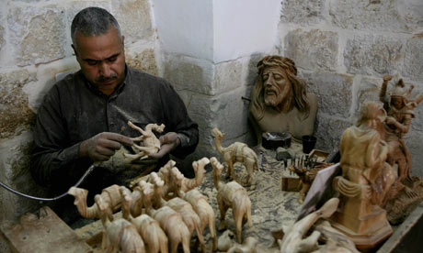
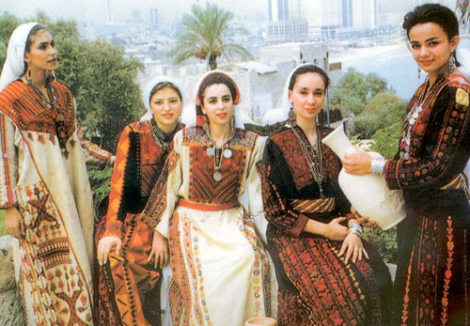
Course Goals
Participants who complete the course will be able to :
Discuss the history, geography, archaeology, and cultural background of ancient Palestine in an informed way.
Identify and discuss some crucial historical problems.

Slide 5
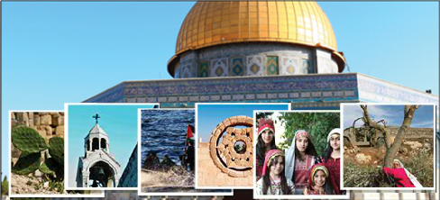
WHY ?

Slide 6
The initiative became as part of the university academic responsibility and social role.
The political conflict is the only issue that Palestine is remembered for,
To introduce Palestine and Palestinians to the international world in a very interactive way by reflecting its beauty, history, geography and culture.

Slide 7
Discover Palestine Team
Course team leader
Instructional designer
Geography Specialist
Archaeology Specialist
Multimedia Specialist
Translator
Evaluator

Slide 8
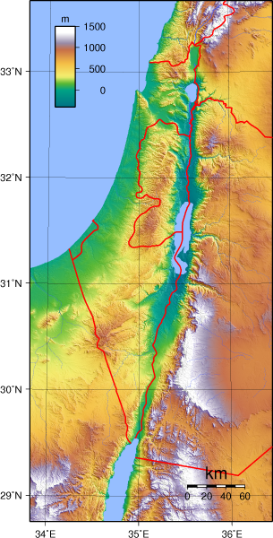
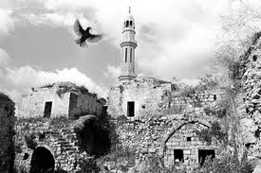
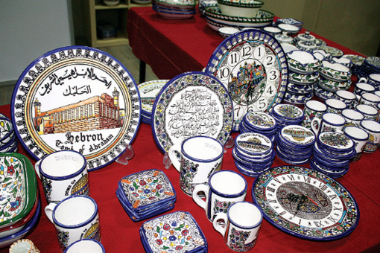
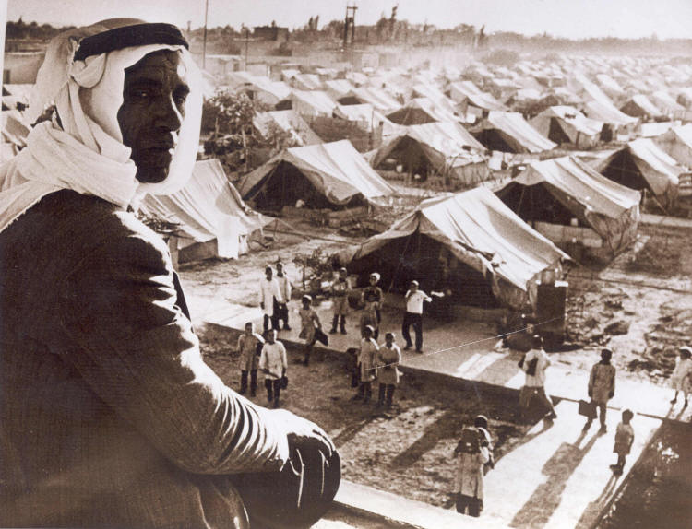
Main Categories
The course consists of five topics:
Geography of Palestine.
The History of Palestine.
Heritage and Culture.
Cities.
Palestine in Photos.
Research Projects.

Slide 9
Learning Materials
Readings
Photos
Videos

Slide 10
Evaluation Tools
31 Forums
2 Projects

Slide 11
28 videos used in Discover Palestine course

Slide 12
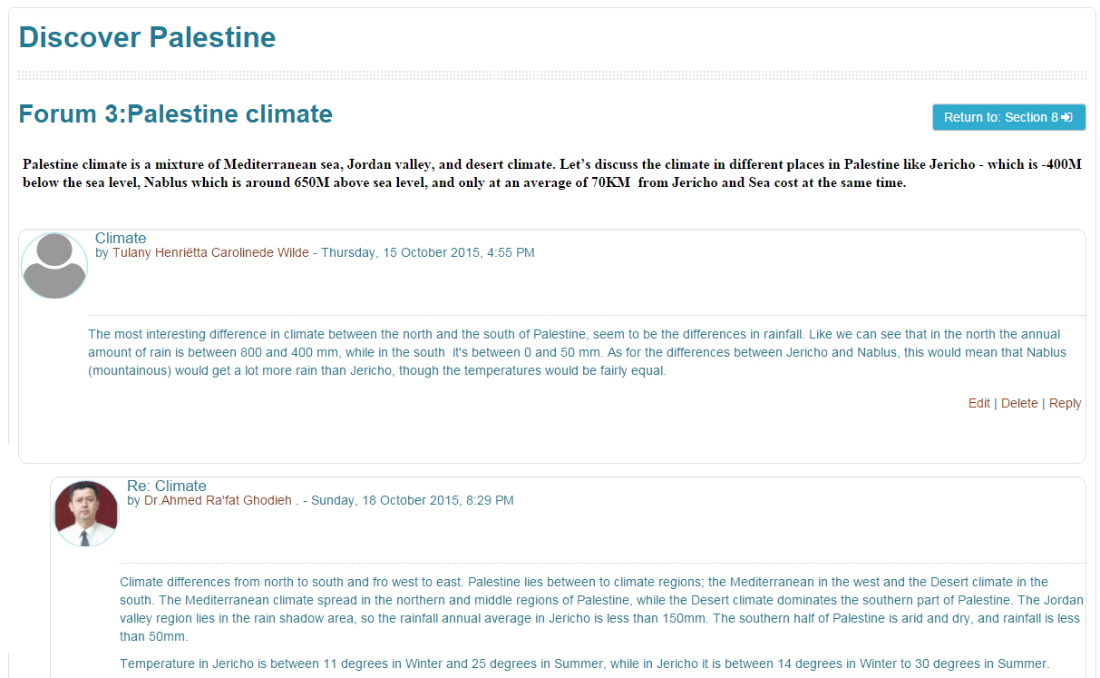
One of the forums

Slide 13
Main Challenges
No previous experience
Lack of experts
Learning by doing
Lack of fund
Unclear map road
Unexpected results

Slide 14
Number of the Participants
Total Number: 285
Gender:

Slide 15
Participant’s Nationalities
Country
United Kingdom
United States
Malaysia
Mexico
Morocco
Netherlands
Palestine
Romania
Slovenia
Spain
Sweden
Yemen
Jordan
Argentina
Ireland
Country
Afghanistan
Australia
Canada
Croatia
France
Germany
Greece
Hungary
Iceland
India
Indonesia
Italy
Chile
China
Colombia
Country
Mauritius
Norway
Pakistan
Serbia
Somalia
Sudan
Switzerland
Thailand
United Arab Emirates
Viet Nam
Bulgaria
Philippines
Portugal
Brazil

Slide 16
How did the learners hear about the course:

Slide 17
Participants' Interest
62% Palestinian History
46% Geography
23% Historic Monuments and Excavations
38% Culture and Heritage

Slide 18
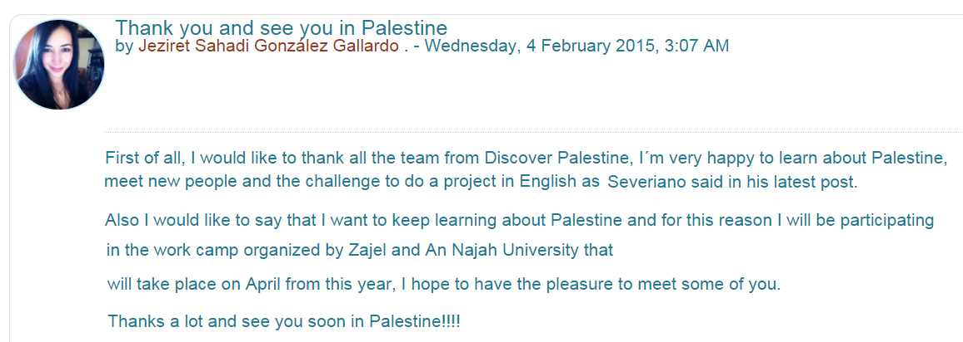
Feedback

Slide 20
Join us https://elc.najah.edu/sites/default/files/flash.htm
00970-9-2345113 ext. 4625
discoverpalestine@najah.edu
http://elc.najah.edu

