Slide 1
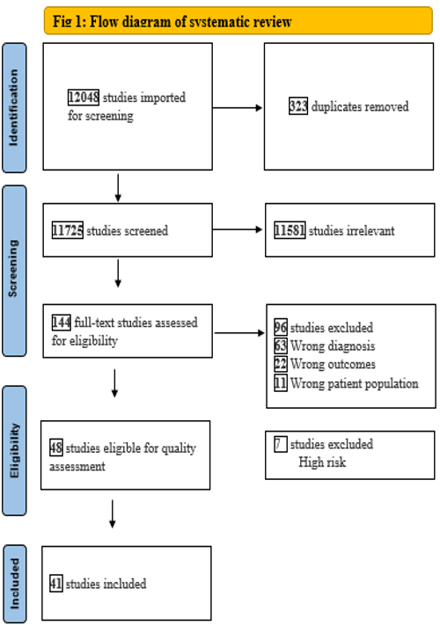
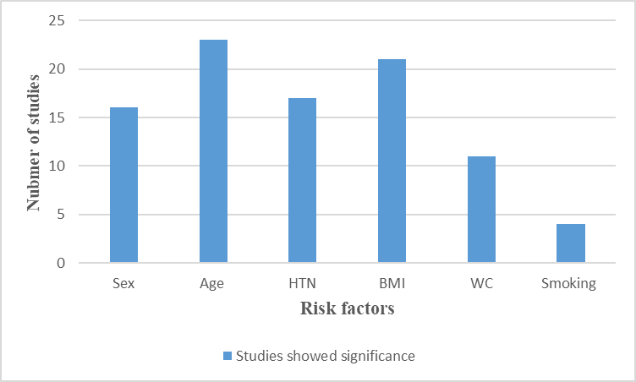
Prevalence and risk factors of prediabetes in the Eastern Mediterranean Region: a systematic review
INTRODUCTION
MATERIALS & METHODS
CONCLUSION
Prediabetes is a serious health condition where blood sugar levels are higher than normal, but not high enough yet to be diagnosed as diabetes.
People with prediabetes have up to a 50% chance of developing diabetes over the next five to 10 years as well as an increased risk of heart disease and stroke.
This SR was planned and carried out in 2022 and was conducted in line with the guideline of the PRISMA statement (2).
Inclusion criteria: observational studies that used either ADA or WHO prediabetes criteria as definitions; on adult populations; in any of the EMR countries and were published at any time in English.
Search in 6 databases (MEDLINE, Scopus, CINAHIL, Pub med, the Web of Science, and Science Direct )
we screened the title and abstract followed by a text review, then we assessed the risk of bias in each study using A quality assessment checklist for the prevalence study and the Newcastle-Ottawa Scale
The prevalence of prediabetes was found to vary across countries in the region
Age, gender, and BMI were among the most frequently reported risk factors for prediabetes in the EMR.
The majority of studies found WC, and high blood pressure to be positively associated with prediabetes.
Other characteristics identified to be positively linked with prediabetes include physical inactivity, poor educational level, dyslipidemia, and family history.
OBJECTIVE
To assess the prevalence and risk factors of prediabetes in the Eastern Mediterranean Region to provide an up-to-date review of the prediabetes status in this region and highlights areas where planning and action are needed. In addition, this study can potentially serve as a platform for future studies on the risks and causes of prediabetes.
RESULTS
28 cross-sectional studies, 6 cohort studies, and 7 case-control studies were identified.
The overall prevalence of PD ranged from 2.2%-47.9%.
Age ,gender and BMI were the most frequently reported risk factors in the EMR.
BMI≥ 25 kg/m² and high blood pressure were positively associated with prediabetes.
Factors like illiteracy, smoking, family history of DM, and physical inactivity were associated with PD in the study population.
Fig1: Flow diagram of Systematic review
Fig 2 Prevalence of prediabetes
Fig 3:Frequency of the significant risk factors
REFRENCES
1. Roglic G. WHO Global report on diabetes: A summary. Int J Noncommunicable Dis [Internet]. 2016 Apr 1;1(1):3–8. Available from: https://www.ijncd.org/article.asp?issn=2468-8827
2. Tricco AC, Lillie E, Zarin W, O’Brien KK, Colquhoun H, Levac D, et al. PRISMA Extension for Scoping Reviews (PRISMA-ScR): Checklist and Explanation. Ann Intern Med. 2018 Oct;169(7):467–73.
3. Hoy D, Brooks P, Woolf A, Blyth F, March L, Bain C, et al. Assessing risk of bias in prevalence studies: modification of an existing tool and evidence of interrater agreement. J Clin Epidemiol. 2012;65(9):934–9.

