Slide 1



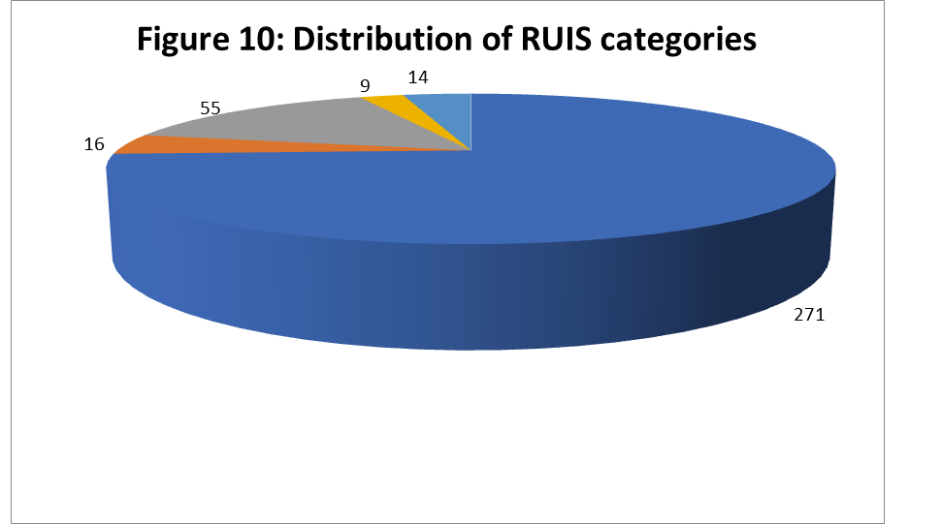
An-Najah National University
Faculty of Medicine & Health Sciences
Department of Nursing &Midwifery
Effects of Episiotomy on Pain, Urinary Incontinence, and Sexual Function Three Months Postpartum: A Descriptive, Analytical, Cross-sectional Study
Prepared by: Montaha Afghani (Leader), Eman khater , Maya Odeh , Reema Narat Submitted to:Dr. Eman Alspohawish, PhD, MCH
Introduction
Result
Result
Background: The episiotomy rate has declined worldwide but remains high in Palestine. The effects of episiotomy on women’s health should be a constant concern. Few data are available on the effect of episiotomy by validated measures.
Objective: The present study aimed to examine the effect of episiotomy on pain, urinary incontinence, and sexual function and identify the demographic characteristic and occurrence of complication up to 3 months postpartum.
Validity and reliability
validated by 5 experts by measuring Cronbach’s alpha = 84.5%,Statistical Analysis (SPSS) version 25 ,3.8 Ethical consideration .conducted in compliance with the Declaration of Helsinki for human medical research.
Distribution of women’s responses to short-form McGill Pain Questionnaire items (PPI = Present Pain Intensity)
Conclusion for women with postpartum urinary incontinence
, pain and sexual function with different types of delivery:
Item | None (0) | Mild (1) | Moderate (2) | Severe (3)
Cramping | 261 (71.0%) | 57 (15.5%) | 33 (9.0%) | 17 (4.6%)
Shooting | 265 (72.0%) | 60 (16.3%) | 31 (8.4%) | 12 (3.3%)
Hot burning | 261 (70.9%) | 44 (12.0%) | 47 (12.8%) | 16 (4.3%)
 | Normal With episiotomy | NSVD without episiotomy | C/S | Values/ Delivery type
109 (62.2%) |  | 44 (25.1%) | 22 (12.6%) | Pain (Out of 175 )
30 (30.9%) |  | 36 (37.1%) | 31 31.9%) | Urinary incontinence (Out of 97)
66 (51.2%) |  | 33 (25.5%) | 30 (23.2%) | Sexual Function (Out of 129)
Distribution of RUIS scores:
Relationship between women’s categorical factors and urinary incontinence, sexual function, and pain
Conclusion
Methodology
Independent variable | Values | Urinary incontinence |  | Sexual function (number of days) |  | Pain (SF-MPQ)
 |  | Mean | p-value | Mean | p-value | Mean | p-value
Hospital type | Gov. | 1.44 | 0.888 | 45.83 | 0.005 | 5.72 | 0.022
 | Private | 1.41 |  | 48.30 |  | 3.74
Delivery type | NSVD | 1.50 | 0.688 | 46.89 | 0.111 | 6.34 | < 0.001
 | CS | 1.41 |  | 47.33 |  | 1.47
Episiotomy | Yes | 1.14 | 0.063 | 48.75 | 0.013 | 11.26 | <0.001
 | No | 1.85 |  | 45.06 |  | 1.50
Episiotomy performer | Midwife | 0.65 | 0.001 | 46.24 | 0.065 | 12.02 | 0.154
 | Doctor | 1.47 |  | 50.42 |  | 10.75
Previous episiotomy | Yes | 1.61 | 0.258 | 45.71 | 0.002 | 4.10 | 0.002
 | No | 1.33 |  | 48.31 |  | 5.37
The current study aimed to investigate the effect of episiotomy and no episiotomy on different factors. The study was conducted using a cross-sectional quantitative approach on a total of 368 women•
Main results found that episiotomy was significantly associated with decreased sexual function . urinary incontinence with less birth weight and when doctors perform the episiotomy, as well as better sexual recovery with more lived births and having previous episiotomies, while more pain was found among younger women, less lived births, deliveries in governmental hospitals and having no previous episiotomies.
Study design:
descriptive, analytical cross-sectional approach
Site and setting:
Palestinian health care clinics in Nablus,
Jenin and Tulkarem cities.
Study population and sampling technique all women who had a delivery in the last 3 months , Convenient sampling technique.
Inclusion and exclusion criteria:
Women with normal or C/S delivery in the last 3 months who had or didn’t had episiotomy and older than 18 Y/O , any woman with abnormalities were excluded
Data collection Methods and tools:
A self-administered questionnaire containing : sociodemographic and gynecological variables, Revised Urinary Incontinence Scale (RUIS), sexual dysfunction open-ended questions, and McGill Pain Questionnaire (SF-MPQ).
Table 4.2: Distribution of postnatal pain as a dichotomous variable
Table 2.3: Distribution of RUIS Among Woman Who Have UI:
Type of Delivery | Has urinary incontinence (> zero) 97 (26.4%)
Normal without episiotomy | 36 (37.1%)
Normal with episiotomy | 30 (30.9%)
C/S | 31 (31.9%)
Conclusion for the relationship between delivery type and
episiotomy, and the postnatal urinary incontinence and pain
Keywords: Comparison, episiotomy, on pain,
urinary incontinence, sexual function,
months postpartum, A prospective, Palestine
Sexual activity/function :
Lastly, the mean time required for women to have intercourse postnatally was 47.03 ± 14.03 days, ranging from 20 to 180 days.
In conclusion the results of psychological and physical causes were as follows:
109 ( 84.4%)women suffered from physical causes and 20 (15.5%) women suffered from psychological causes out of the total number of women who answered yes.
Independent variable | Urinary incontinence |  | Sexual function (number of days) |  | Pain (SF-MPQ)
 | Pearson | p-value | Pearson | p-value | Pearson | p-value
Age | 0.59 | 0.261 | 0.002 | 0.965 | - 0.212 | < 0.001
Mother’s weight | 0.077 | 0.139 | 0.059 | 0.257 | - 0.080 | 0.127
Lived births | 0.092 | 0.080 | - 0.131 | 0.012 | - 0.246 | < 0.001
Birth weight | - 0.116 | 0.026 | - 0.089 | 0.087 | 0.081 | 0.120
References
BANAEI, M., MORIDI, A. & DASHTI, S. 2018. Sexual Dysfunction and its Associated Factors After Delivery: Longitudinal Study in Iranian Women. Mater Sociomed, 30, 198-203.
CARROLI, G. & MIGNINI, L. 2009. Episiotomy for vaginal birth. Cochrane Database Syst Rev, Cd000081.

