Slide 1
Institutionalizing Learning
“Learning environment that promotes learning culture”
Maher Y. ARAFAT
An-Najah National University
AMIDEAST, PFDP,
5th Academic Colloquia, July 2011,

Slide 2
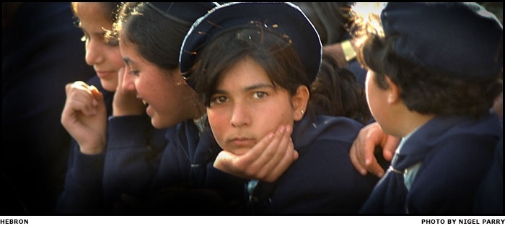
Photo credit: Electronic Intifada
2

Slide 3
Three Paradigm shifts (Eijkman,2009)
The post-information shift in learning practices
Industrial Age - Info Age - Post-Info Age
The social shift in learning theory
Cognitivism - Constructivism - Social constructivism
The participatory shift in learning technology
Web 1.0 – Post-Web 1.0 – Web 2.0, 3.0 etc.
A macro shift ?
Fundamental challenges to old practices
3
Notes:
The way we re-organise teaching
The way we re-think about learning
The way we re-use new technologies
3

Slide 4
Traditional Learning Triangle.
Student
Content
Teacher

Slide 5
Learning Triangle.
Content
Teacher
Learner
Text or Teacher Based
Instructor
Constructor
Digital Content
e-Option
Notes:
Post info-shift Digital Content
Social shift Constructors
Participating & Experimenting e-Option

Slide 6
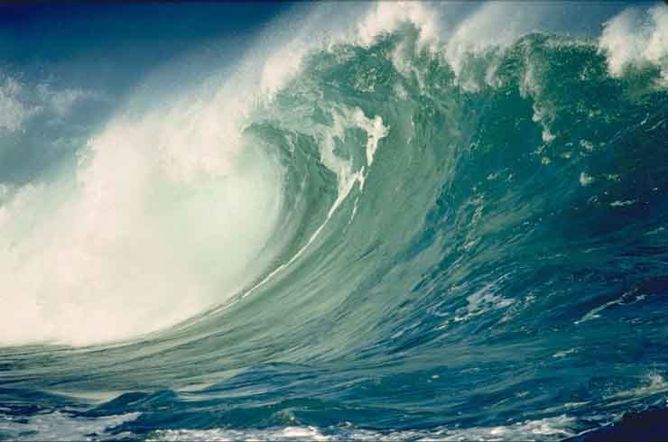
The Goal of Education in the 21st century Tsunamis
Allowing learners to realize their capacity to learn, (Learning Environment & Learning Spaces)
Moving education from delivery of static info to a more:
“a dialogical relation where knowledge is co-created”
(Josie Gregory, Facilitation and Facilitator Style, p.99)
“Socially Interactive Participation in Meaning Making.”
Notes:
if we are to survive the 21st century Tsunamis, we need to learn how to swim,
facilitate learning and incorporating CHANGE to happen instead of trying to Control it.
This can be achieved by:

Slide 7
Concerns, Questions, Inquiries
To highlight the importance of :
Excellence in Teaching
to yield
Excellent Learning
Notes:
I hope that, through a series of questions and inquiries to reflect on, the presentation thesis will highlight the importance of excellence in teaching to yield excellent learning; moreover, I intend to share with you some real concerns to be at the forefront of our attention, as it has been pushed, for so long, to be hidden in the back of our minds as trivial matters.

Slide 8
What our educational system has produced for our society during the last decades?
excellent students in passing exams and bringing home high marks.
or
Enabling students to think critically, reflect, create , and innovate.

Slide 9
What does it really mean to be a learner centered?
Is centricity around the learners’ learning needs and preferences, a good thing to do?
If so, it is crucially important to train teachers to do it right.
Notes:
Add value activity.

Slide 10
Are we preparing our children to the 21st century?
Are they armed with the required competency and skills (LLL, collaborative, self-directed)
Will they be able to compete, globally or regionally?
(Students Internationalization )
What are the consequences? ! ? ! ? ! ? ! ? ! ?
Notes:
The biggest challenge a head

Slide 11
The strategic importance to CHANGE
2011-2023 Formal Schooling.
2023-2027, 2030 Graduate
2030-2070 Pushed to the labor Market
-----------
Notes:
Producing graduates unskilled and not prepared for the 21st century CHALLENGE.

Slide 12
Quality Learning Equation QEE
Learning
Improved
Teaching:
Learning:
Method
Tools
Skills
Method
Tools
Skills
SME
+
STD
=
Learning
Organizational Support, Training, Services.
Learner Needs
Learner Preferences
Learning Environment
Learning Spaces
Quality Learning

Slide 13
Equally important is the educational
Culture & Environment.

Slide 14
The Educational Culture is:
How we do things in our own environment?

Slide 15
The Educational Environment
The physical environment:
classes, e-enabled learning spaces to facilitate engagement
The virtual learning environment:
demanded by the digital-learners of today,
an e-enabled learning environment.
Do we have the right environment that promotes students’ collaboration, interaction, and teamwork?

Slide 16
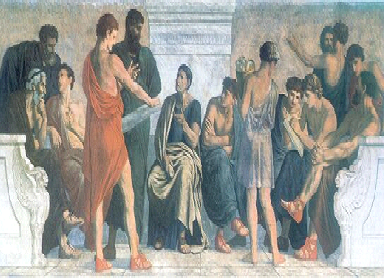
Pre Print Learning
Notes:
Pre print Revolutions

Slide 17
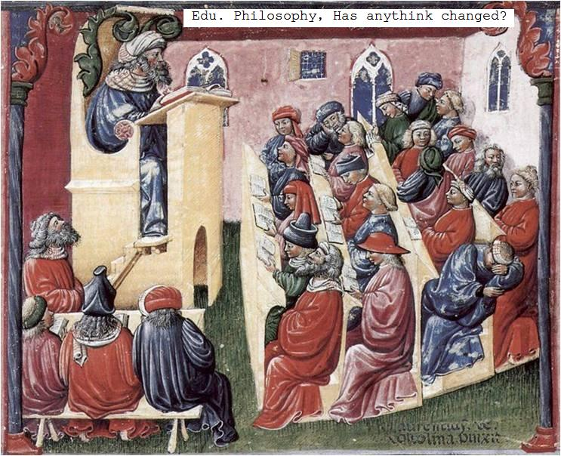
Notes:
After print revolution

Slide 18
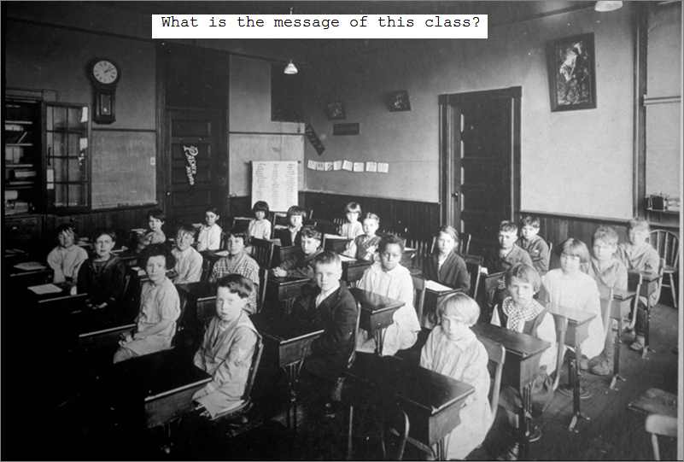
Notes:
Formal educational systems revolution

Slide 19
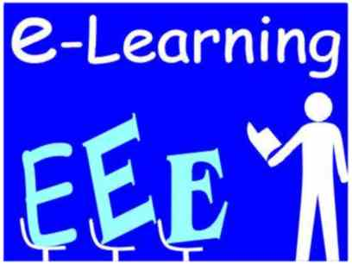
Interactive
Participation
Socially
In
Meaning
Making
Notes:
The e revolution
The learners e learning needs and preferences
Different learning preferences
Text and teacher based ( Chalk & Talk) 20th century teachers.

Slide 20
The growing effect of Modernity.
Reflexive Post-Modern Society
is Learning Society
Modernity
Continuously
Changing
Environment
Needs
Planning,
Objectives
How to Teach
Thinking
Learning
Reflecting
Outcomes
Maher Y. ARAFAT 2011
Notes:
Effect of modernity on environment and on needs.
“Certainty impossible” ----- caused by modernity ---- causing environment change.
Our rationality is bounded by environment,
Our needs are changing in response to changes in environment affected by modernity.

Slide 21
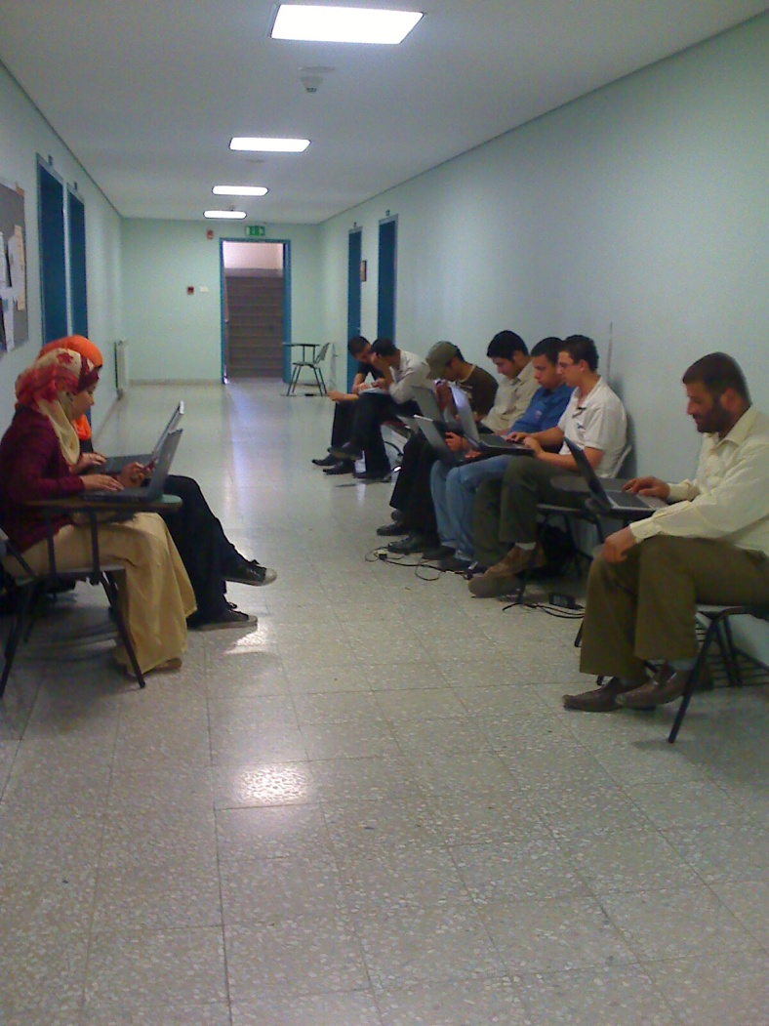
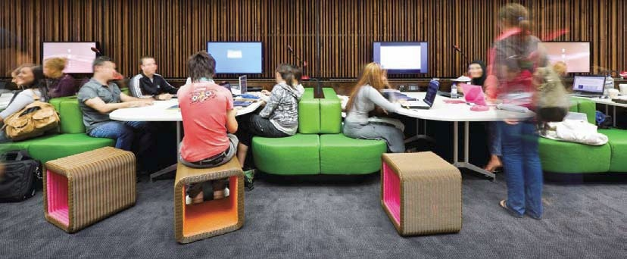
A learning space where students can plug in their laptop to digitally capture hand notes, surf the web, connect to university databases, watch a movie, tubes, blogs and participate in discussions.

Slide 22

Interactive
Participation
Socially
In
Meaning
Making
Notes:
Chapter Zero, Lesson Zero,

Slide 23
Administrative Role
Staff: Empowerment, How to teach?,
Centers for Excellence in Teaching.
Student: Competency, skills, attitudes
Admin.: The need to restructure, the e-infrastructure, edu-resources, Non-curricula activities, Learning Environment, Learning Spaces

Slide 24
Teachers’ Role
What to teach? or How to teach?
“What happens to another person in your presence is a function of who you are and not what you know.”
(from Ram Dass, The Only Dance There Is)
تأثيرنا على الآخرين ... هو نتيجة لشخصيتنا، وليس نتيجة المعرفة لدينا“
The need to have 360° view of our students.
Teaching, at its best, sometimes, its clowning.

Slide 25
المدرسون نوعان:
اما مدرس متمكن.
او
المدرس القدوة.
لماذا لا يكون المدرس مبدعاً، اي ( قدوة متمكن)

Slide 26
The Learner Role
Our duty is to help learner to become active learner, with personal agency to be:
Self-directed.
Intrinsically curious.
Motivated to learn.
Self monitoring and self correcting.

Slide 27
Things that we do not need?
Thought Control
Thought Control
Thought Control

Slide 28
What do we need?
we need an innovation oriented system, focusing on solving real-life problems and challenges, globally.
Acknowledge the responsibility to craft e-enabled Learning Environment.
Ability to identify problem, opportunity, need
Work harder, learn faster, think sharper.
Develop skills, values, and attitudes
Freedom to think. Not accept things as they are to generate new ideas.
No fear of making mistakes, as we learn better from our mistakes.

Slide 29
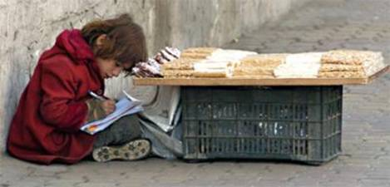
“The harder the conflict the more glorious the triumph” Thomas Paine 1776
Thank You
If not us, … WHO?
If not now, … WHEN?

